Slide 1
BU7150 — Business Decision Optimization
Goal Programming Practice Problem
Integer Programming
Dr. Isilay Talay
Assistant Professor in Operations and Supply Chain Management
Date 02/28/2023

Slide 2
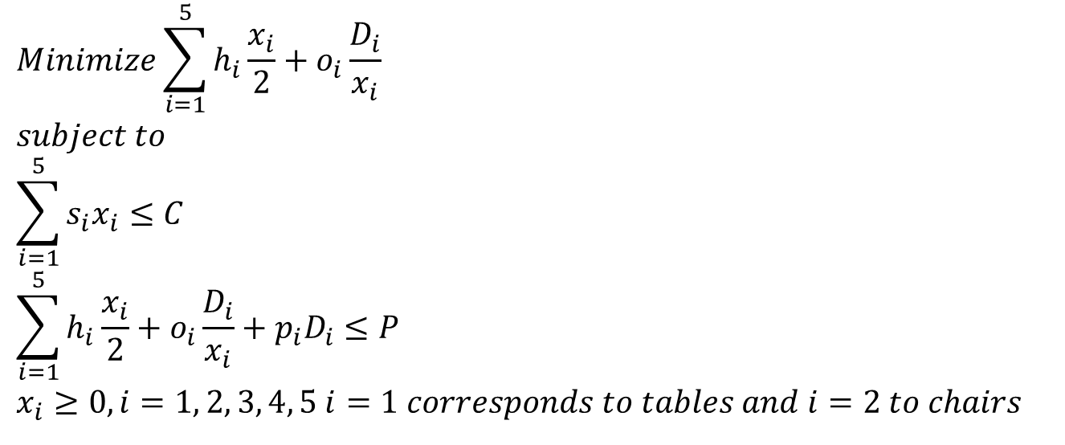
Goal Programming Example
World Class Furniture – NLP Formulation (To remind)
$$Minimize\sum_{i=1}^{5}{h_{i}\frac{x_{i}}{2}}+o_{i}\frac{D_{i}}{x_{i}}$$
$$subject to$$
$$\sum_{i=1}^{5}{s_{i}x_{i}}≤C$$
$$\sum_{i=1}^{5}{h_{i}\frac{x_{i}}{2}}+o_{i}\frac{D_{i}}{x_{i}}+p_{i}D_{i}≤P$$
$$x_{i}≥0, i=1, 2, 3, 4, 5 i=1 corresponds to tables and i=2 to chairs$$

Slide 3

Goal Programming Example
World Class Furniture – Goal Programming Formulation
$Minimize Z=1000\left(s_{1}^{−}+s_{1}^{+}\right)+50s_{2}^{+}+$ $s_{3}^{+}$
$$subject to$$
$$\frac{x_{1}}{x_{2}}+s_{1}^{−}−s_{1}^{+}=0.25$$
$$\sum_{i=1}^{5}{s_{i}x_{i}+s_{2}^{−}−s_{2}^{+}}=200000$$
$$\sum_{i=1}^{5}{h_{i}\frac{x_{i}}{2}}+o_{i}\frac{D_{i}}{x_{i}}+s_{3}^{−}−s_{3}^{+}=7000$$
$$\sum_{i=1}^{5}{h_{i}\frac{x_{i}}{2}}+o_{i}\frac{D_{i}}{x_{i}}+p_{i}D_{i}≤1500000$$
$$x_{i}≥0, i=1, 2, 3, 4, 5 i=1 corresponds to tables and i=2 to chairs$$

Slide 4
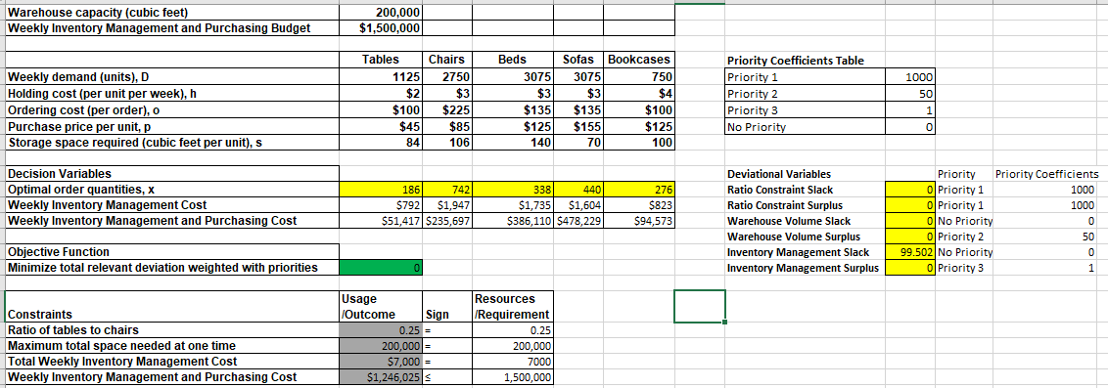
Goal Programming Example
World Class Furniture – Goal Programming Formulation

Slide 5
Goal Programming Case
Apoorva: A Facility Location Dilemma
What challenges is Rao facing?
What are the feasible locations for the new restaurant?
How should Rao evaluate the locations for his new restaurant?
Can Rao use the goal programming technique to select the best location? What are the appropriate decision variables? What are the hard constraints (You use the equality ‘=‘ sign and do not include slack or surplus variables so it must be applied absolutely)? What are the soft constraints (You are ok with having slack or surplus with them)? What is the objective function?
Will the location change if Rao allocates weights to criteria based on his intuition versus he uses the weights recommended in the survey report?
What should Rao do, and why?

Slide 6
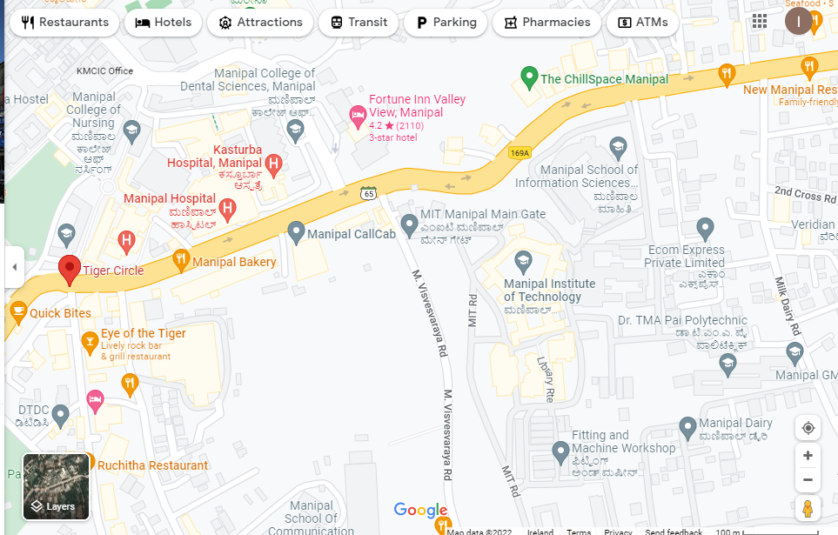
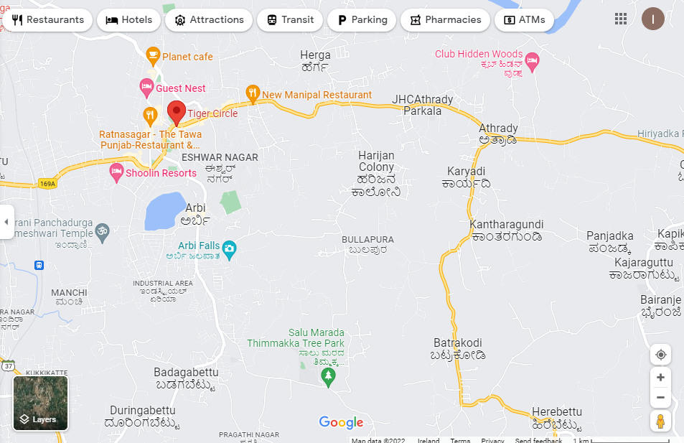
Goal Programming Case
Apoorva: A Facility Location Dilemma – What challenges is Rao facing?
T. A. Pai Management Institute (TAPMI)
X

Slide 7
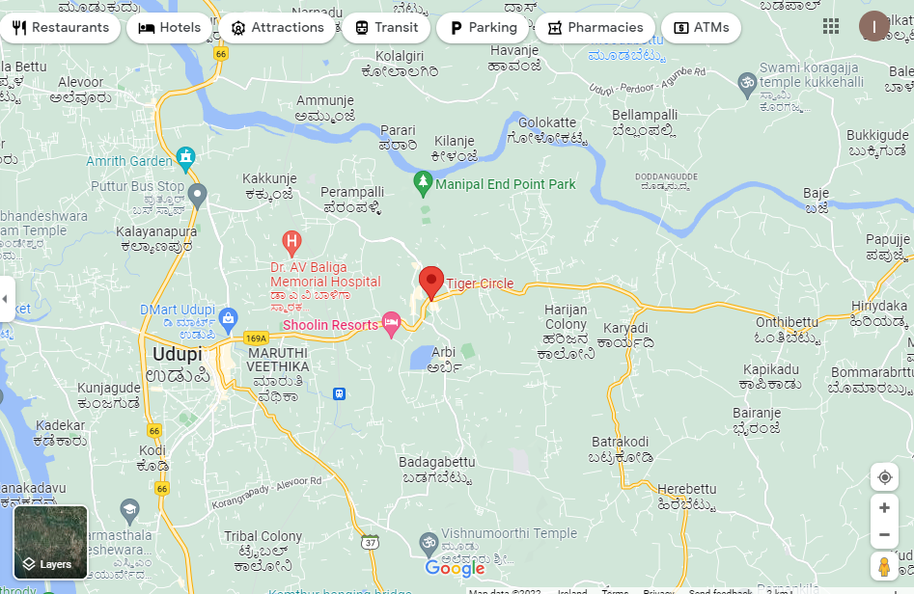
Goal Programming Case
Apoorva: A Facility Location Dilemma – What challenges is Rao facing?
Customer base:
90% - Ugrads and Postgrads from Manipal (registered with discount)
Patients, labourers, budget tourists from Manipal-Udupi region:
-Patients (many hospitals and medical schools present)
-Labourers (government and corporations’ infrastructure projects)
-Tourists (Udupi Krishna temple and other spiritual places)
Main complaint from unregistered users:
-too far to come regularly
-heavy rainfall June-Sep, public transport and schools are affected

Slide 8
Goal Programming Case
Apoorva: A Facility Location Dilemma
What challenges is Rao facing?
-Competition
Mavalli Tiffin Room, Sagar Ratna, KFC, Subway, Pizza Hut, Domino’s Pizza, and similar
Online food aggregators
-TAPMI leadership change triggering a policy change in catering
Three more vendors included and monthly subscription changed with daily plan
-Cannot reach to all customer bases yet
-Wishes to serve quality food at affordable rates to the lower middle class
RAO’S SOLUTION: Opening a full-service economical restaurant in the Manipal-Udupi region

Slide 9
Goal Programming Case
Apoorva: A Facility Location Dilemma
2) What are the feasible locations for the new restaurant?
6 feasible regions (Exhibit 4):
Western side of Manipal, within the Udupi municipal region: Thenkpete, Kunjibettu, Chitpady, Ambalpadi
Rural setting on the eastern side of Manipal: Hiriadka, Parkala
3) How should Rao evaluate the locations for his new restaurant?
BrandScan survey:
Customer segments (Exhibit 5A) – Tourists, Labour, Patients, Students, Locals (Do we need all of them?)
Criteria set with (Target Values with StDev + Relative Importance) (Exhibit 5B)
-size of facility (SF)
-size of parking space (AP)
-response time for home delivery (RT)
-availability of infrastructure (AI)
-size of target population (STP) (Derived from Ex-5A and Ex-6)
-availability of road network (AR)
-number of competitors (NC)
-distance to market (DM)

Slide 10
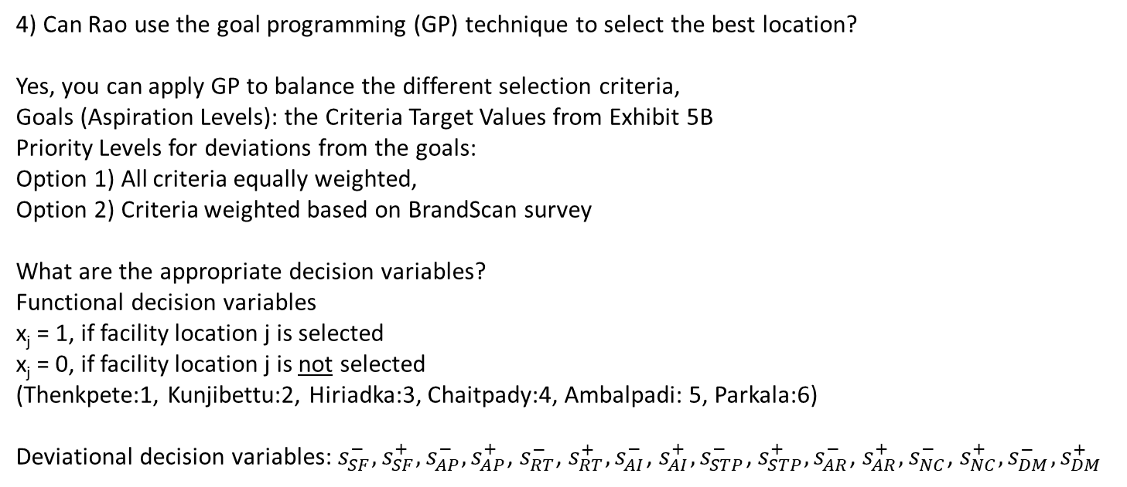
Goal Programming Case
Apoorva: A Facility Location Dilemma
4) Can Rao use the goal programming (GP) technique to select the best location?
Yes, you can apply GP to balance the different selection criteria,
Goals (Aspiration Levels): the Criteria Target Values from Exhibit 5B
Priority Levels for deviations from the goals:
Option 1) All criteria equally weighted,
Option 2) Criteria weighted based on BrandScan survey
What are the appropriate decision variables?
Functional decision variables
x_{j} = 1, if facility location j is selected
x_{j} = 0, if facility location j is not selected (Thenkpete:1, Kunjibettu:2, Hiriadka:3, Chaitpady:4, Ambalpadi: 5, Parkala:6)
Deviational decision variables: $s_{SF}^{−},s_{SF}^{+},s_{AP}^{−},s_{AP}^{+}$, $s_{RT}^{−}$, $s_{RT}^{+},s_{AI}^{−}$, $s_{AI}^{+},s_{STP}^{−}$, $s_{STP}^{+},s_{AR}^{−}$, $s_{AR}^{+},s_{NC}^{−}$, $s_{NC}^{+},s_{DM}^{−}{,s}_{DM}^{+}$

Slide 11
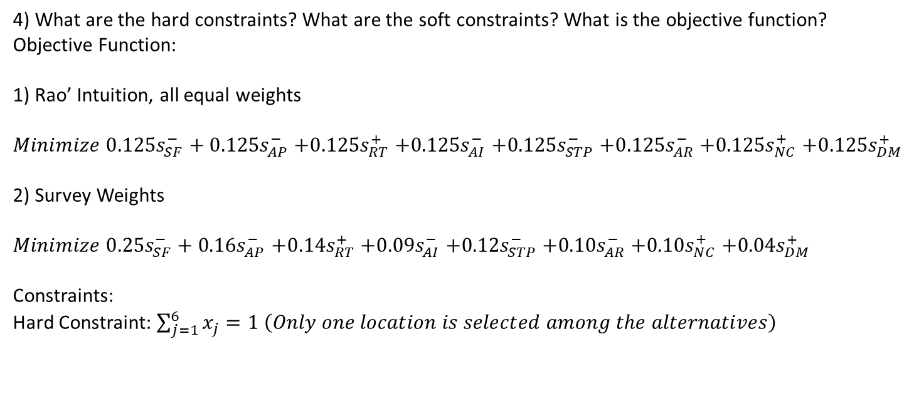
Goal Programming Case
Apoorva: A Facility Location Dilemma
4) What are the hard constraints? What are the soft constraints? What is the objective function?
Objective Function:
1) Rao’ Intuition, all equal weights
${Minimize 0.125s}_{SF}^{−}+{0.125s}_{AP}^{−}$ ${+0.125s}_{RT}^{+}{+0.125s}_{AI}^{−}{+0.125s}_{STP}^{−}{+0.125s}_{AR}^{−}$ ${+0.125s}_{NC}^{+}{+0.125s}_{DM}^{+}$
2) Survey Weights
${Minimize 0.25s}_{SF}^{−}+{0.16s}_{AP}^{−}$ ${+0.14s}_{RT}^{+}{+0.09s}_{AI}^{−}{+0.12s}_{STP}^{−}{+0.10s}_{AR}^{−}$ ${+0.10s}_{NC}^{+}{+0.04s}_{DM}^{+}$
Constraints:
Hard Constraint: $\sum_{j=1}^{6}{x_{j}}=1 \left(Only one location is selected among the alternatives\right)$

Slide 12
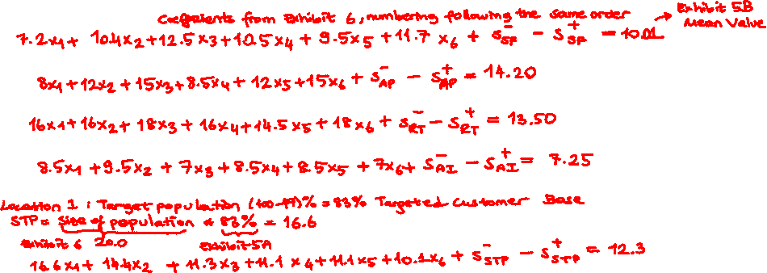
Goal Programming Case
Apoorva: A Facility Location Dilemma
4) What are the hard constraints? What are the soft constraints? What is the objective function?
Soft constraints (Coefficients from Exhibit 6 and deviations, RHS from Survey target values)
-size of facility (SF) :
-size of parking space (AP):
-response time for home delivery (RT):
-availability of infrastructure (AI):
-size of target population (STP) (Derived from Ex-5A and Ex-6):

Slide 13
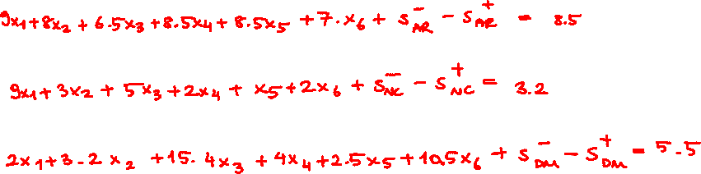
Goal Programming Case
Apoorva: A Facility Location Dilemma
4) What are the hard constraints? What are the soft constraints? What is the objective function?
Soft constraints (Coefficients from Exhibit 6 and deviations, RHS from Survey target values)
-availability of road network (AR):
-number of competitors (NC):
-distance to market (DM):

Slide 14
Goal Programming Case
Apoorva: A Facility Location Dilemma
5) Will the location change if Rao allocates weights to criteria based on his intuition versus he uses the weights recommended in the survey report?
6) What should Rao do, and why?
Different approaches, not clear-cut since deviations are not zero in any of them
SF/STP, AP/STP, RT, AR, NC, and DM favors Ambalpadi, AI favors Kunjibettu, Rao chose Ambalpadi and left Manipal district’s management completely to Poojari since Ambalpadi was further away from Manipal,
Indeed, 3 competitor restaurants opened in Kunjibettu, a competitor left the main base TAPMI (easier for Poojari to manage), and Rao got a very good deal for Ambalpadi location’s price, so the decision turned our to be a good one

Slide 15
Integer Programming
Revisiting Rolls Bakery
With two changes:
Max Z = 400x₁ + 300x₂ (Objective function)
Subject to:
10x₁ + 15x₂ ≤ 150 (Machine hours constraint)
x₁ ≥ 3 (Demand for DRC)
x₂ ≥ 3 (Demand for SRC)
x₁, x₂ ≥ 0 and integer (non-negativity and integer constraints)

Slide 16
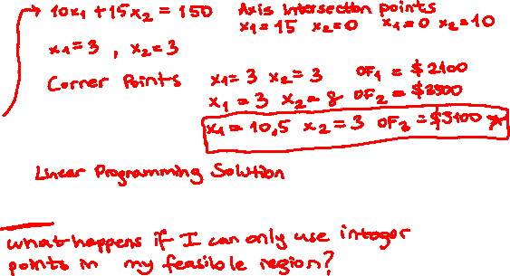
Integer Programming
Revisiting Rolls Bakery
With two changes:
Max Z = 400x₁ + 300x₂ (Objective function)
Subject to:
10x₁ + 15x₂ ≤ 150 (Machine hours constraint)
x₁ ≥ 3 (Demand for DRC)
x₂ ≥ 3 (Demand for SRC)
x₁, x₂ ≥ 0 and integer (non-negativity and integer constraints)

Slide 17
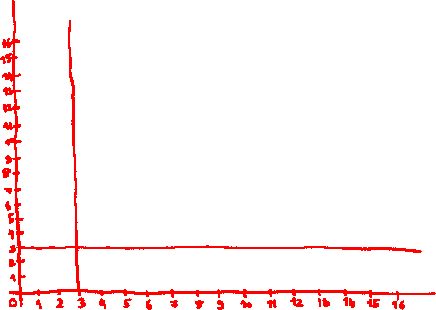

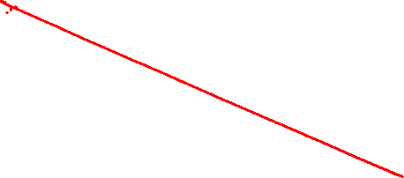
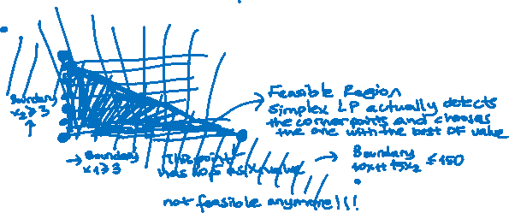
Integer Programming
Revisiting Rolls Bakery
With two changes:
Max Z = 400x₁ + 300x₂
Subject to:
10x₁ + 15x₂ ≤ 150
x₁ ≥ 3
x₂ ≥ 3
x₁, x₂ ≥ 0 and integer

Slide 18
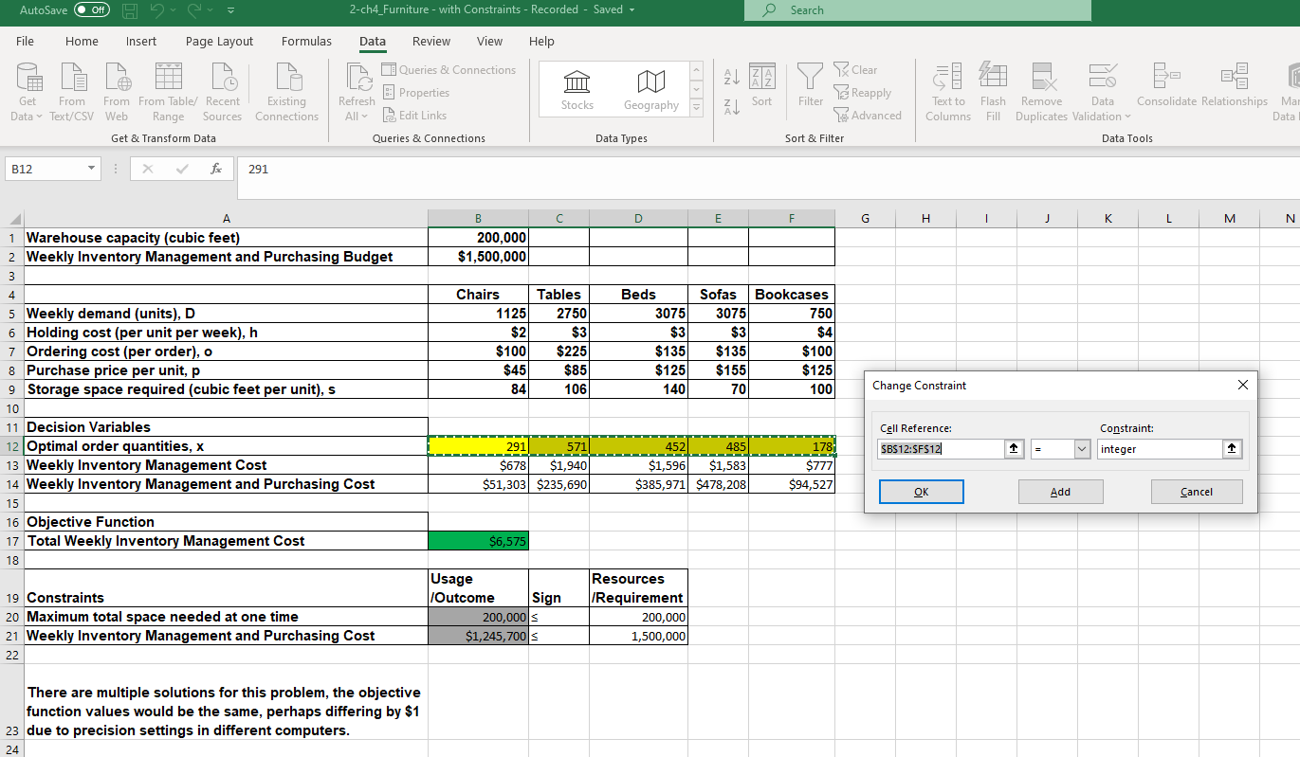
Integer Programming
Revisiting World Class Furniture

Slide 19
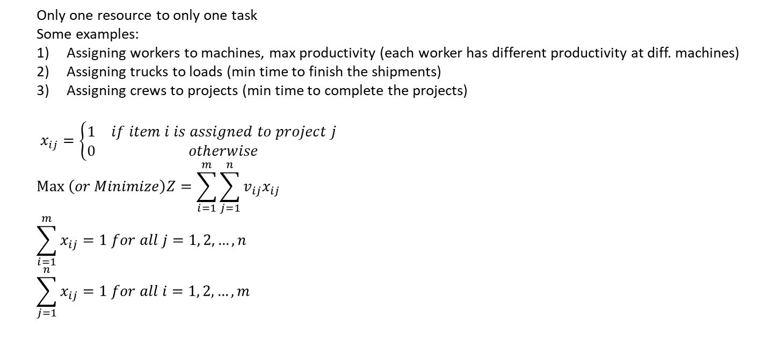
Integer Programming
Assignment Problem – General Structure
Only one resource to only one task
Some examples:
Assigning workers to machines, max productivity (each worker has different productivity at diff. machines)
Assigning trucks to loads (min time to finish the shipments)
Assigning crews to projects (min time to complete the projects)
$x_{ij}=\left\{\begin{matrix}1 & if item i is assigned to project j \\ 0 & otherwise\end{matrix}\right.$
$$Max \left(or Minimize\right)Z{=\sum_{i=1}^{m}{\sum_{j=1}^{n}{v_{ij}x_{ij}}}}$$
$$\sum_{i=1}^{m}{x_{ij}}=1 for all j=1, 2, …, n$$
$$\sum_{j=1}^{n}{x_{ij}}=1 for all i=1, 2, …, m$$

Slide 20
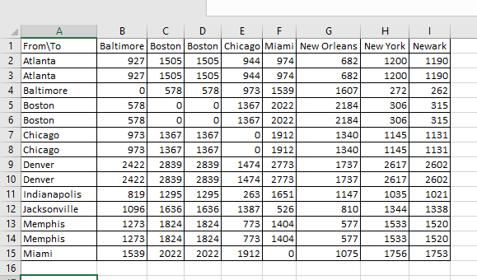
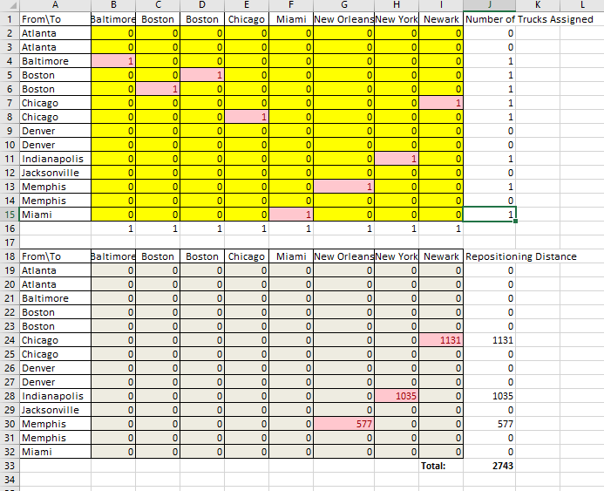
Integer Programming
Assignment Problem – Shipment Example

Slide 21
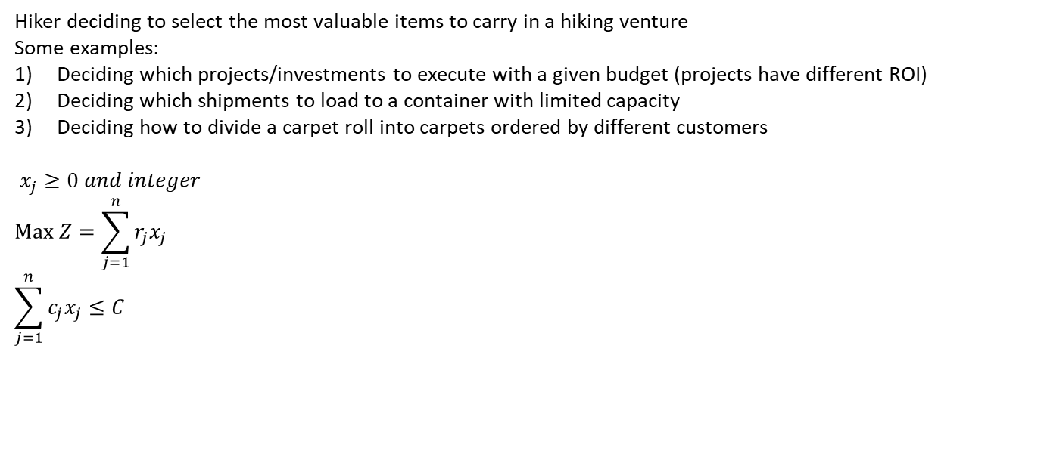
Integer Programming
Knapsack Problem – General Structure and Revisit Paint Primer Production
Hiker deciding to select the most valuable items to carry in a hiking venture
Some examples:
Deciding which projects/investments to execute with a given budget (projects have different ROI)
Deciding which shipments to load to a container with limited capacity
Deciding how to divide a carpet roll into carpets ordered by different customers
$x_{j}≥0 and integer$
$$Max Z{=\sum_{j=1}^{n}{r_{j}x_{j}}}$$
$$\sum_{j=1}^{n}{c_{j}x_{j}}≤C$$

Slide 22
Integer Programming
Types of Integer Programming Models
Examples Covered in the Module and Solving Methods for Mathematical Programming | Structure of Objective Function and Constraints
 | Linear + Goal (Simplex LP) | Nonlinear + Goal
 |  | Smooth (GRG Nonlinear) | Nonsmooth (Evolutionary) + Excel If-Then, Vlookup, Hlookup
All decision variables are real numbers | Insulation Production Paint Primer Rolls Bakery Political Promotion Landhills Winery | Electricity Pricing Portfolio Optimization World Class Furniture OPAC Assessment EOQ Model | Not covered in the module, could be mastered if the material covered is mastered
All decision variables are either integers or 0-1 type variables | Paint Primer Revisited Rolls Bakery Revisited (Integer + Goal) Assignment Problem Knapsack Problem DHL Supply Chain Apoorva (Integer + Goal) | World Class Furniture Revisited (Integer + Goal)
Some decision variables are integers and/or 0-1 type variables and the rest are real numbers | Landhills Winery, Production upper bound on the first product added | Not covered in the module, could be mastered if the material covered is mastered

